Slide 1
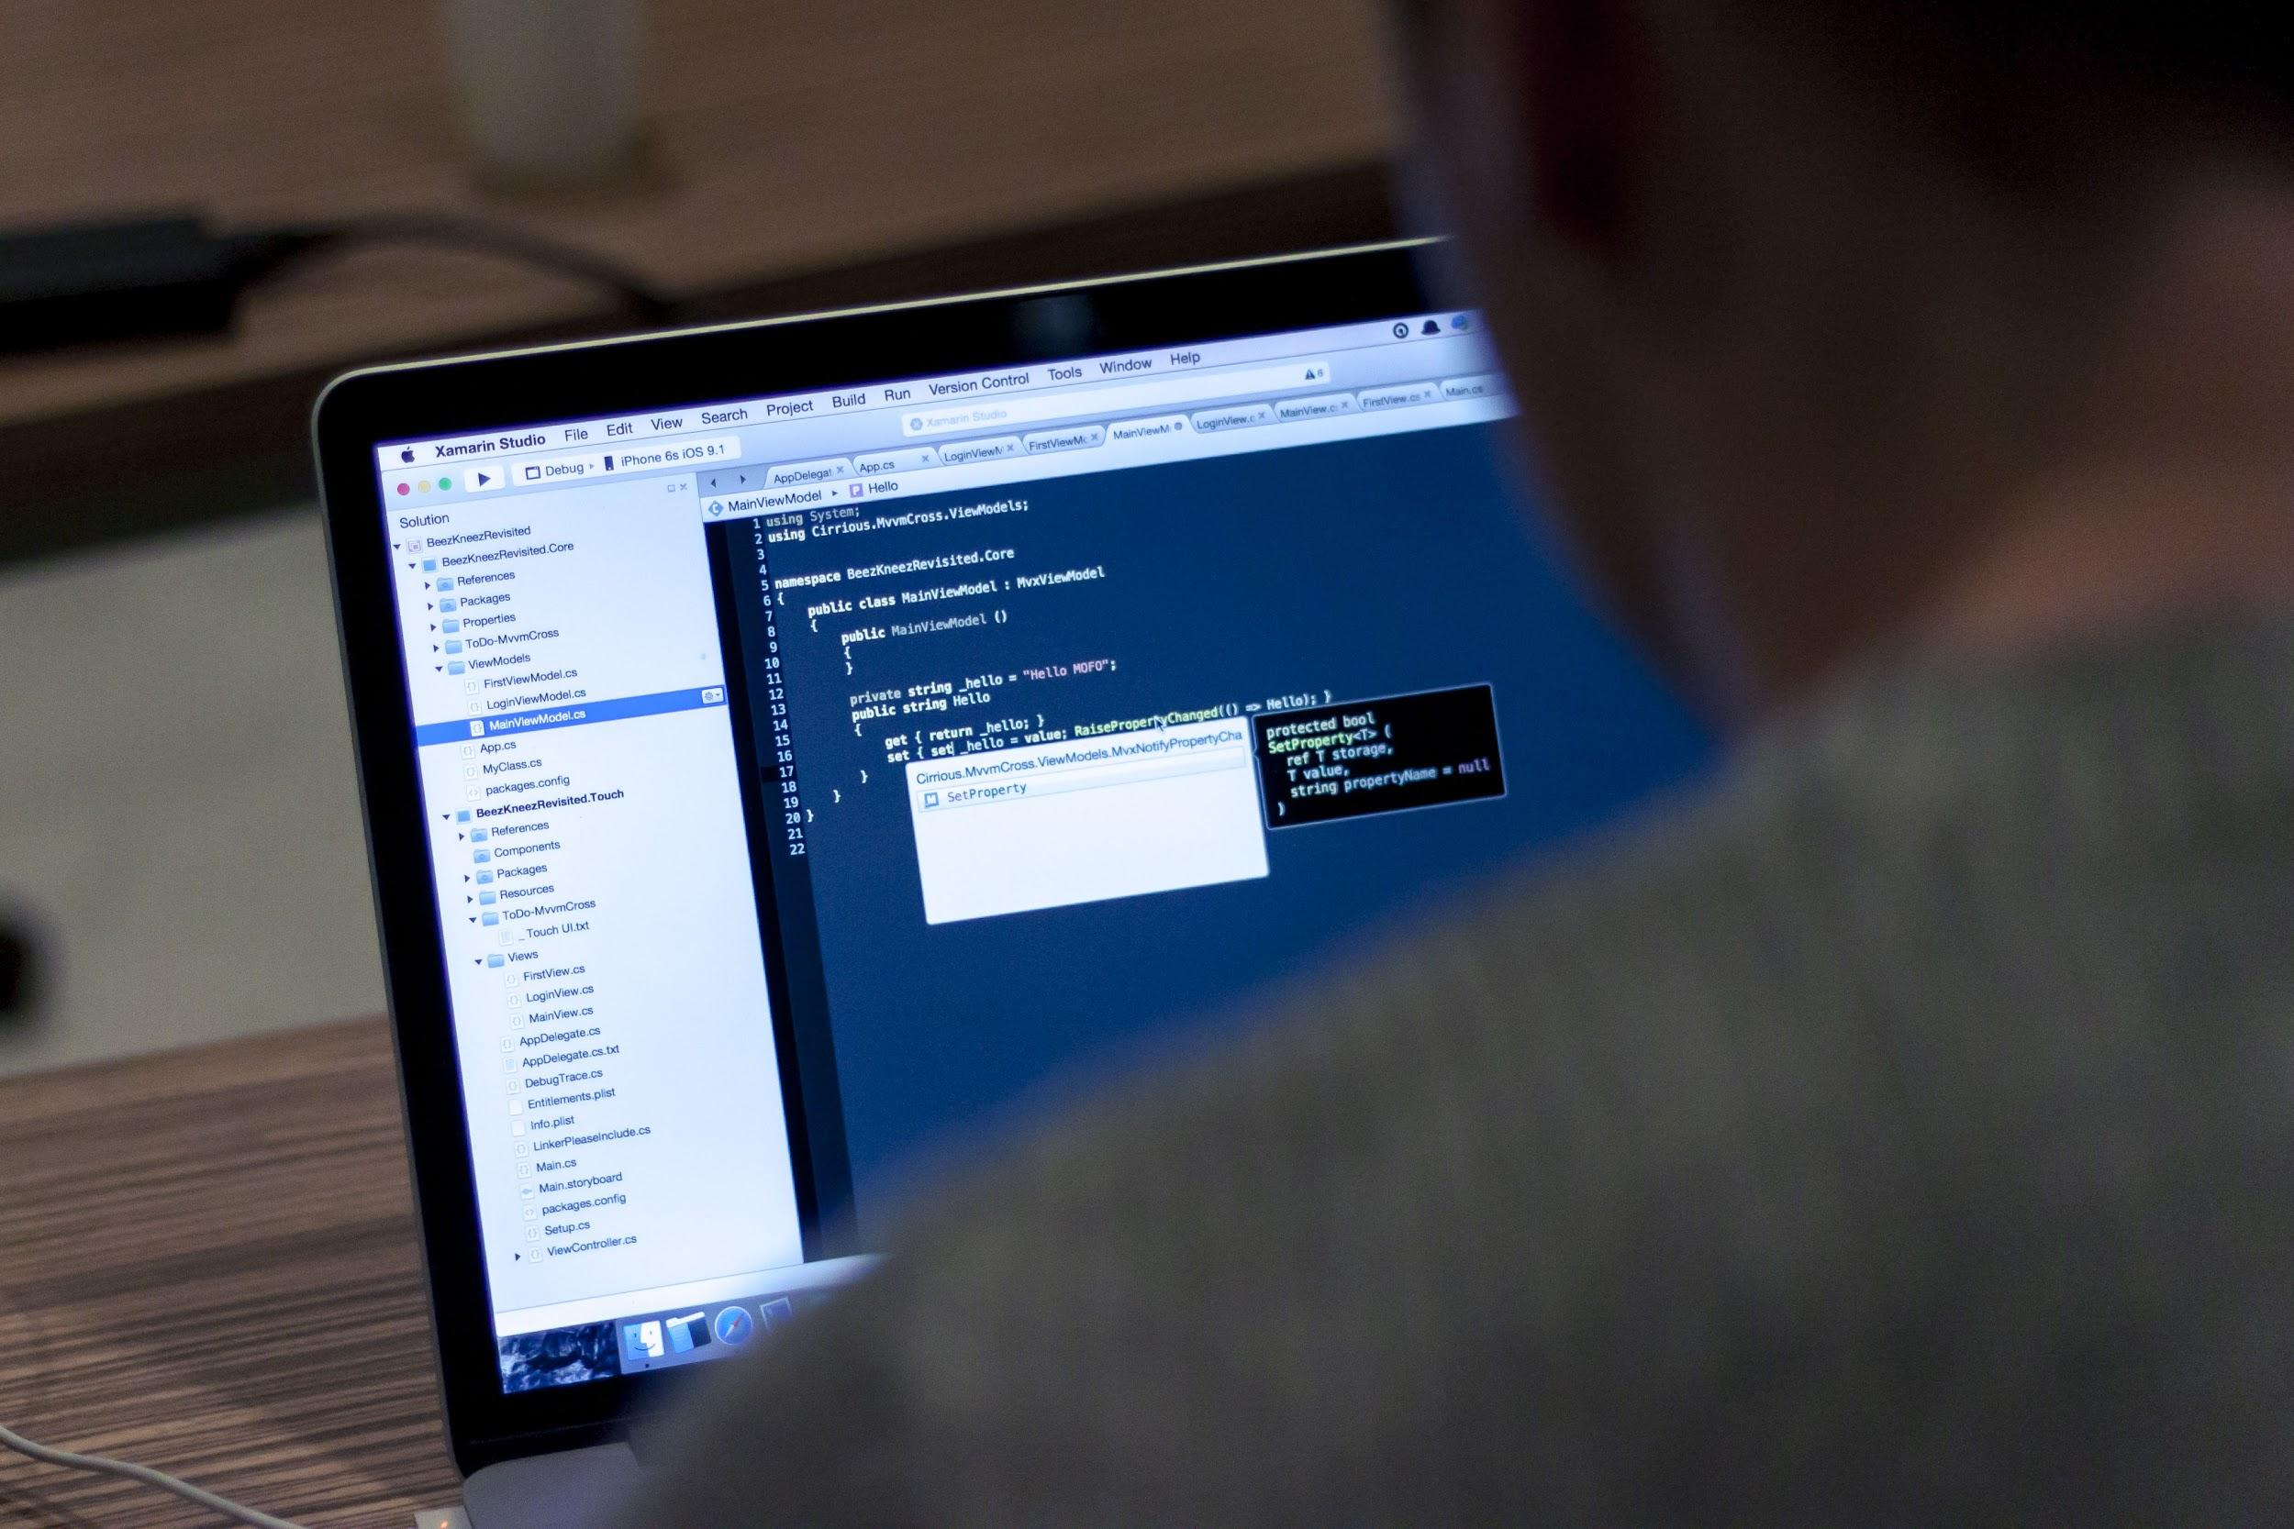
JavaScript 107
Tic Tac Toe Game

Slide 2

Review
Variables
Create
Read
Update
Delete
Arrays
Add an element (Create)
Retrieve an element (Read)
Change an element (Update)
Remove an element (Delete)
Loops
for()
while()
jQuery
Serve locally vs. via CDN

Slide 3
Today’s Topics
Build a simple Tic-Tac-Toe game

Slide 4
Game Features
Board should be a 3x3 grid
The app allows two human players play against each other (NOT human vs. computer!)
Player 1 is X, Player 2 is O
The app should display current player number (1 or 2) so players know whose turn it is
When a user clicks a square, the app should place an X or an O in that square (depending on which player’s turn it is)
Bonus: app should decide if a player has won, and announce it via an alert()

Slide 5
Pre-Programming Class Discussion
Discuss these things before beginning:
Best way to lay out the grid?
How to identify each square?
What event handlers are needed?
What functions are needed? (Hint: functions are good for updating different parts of the screen)

Slide 6
Bonus Features for Advanced Students
Finish the basic game before attempting to add these features!
Who won? Determine which player won and take appropriate action (discuss: what actions would be appropriate?)
Player names: Add the ability for players to input their names before the game starts. Game should use player names instead of numbers when announcing which player’s turn it is.
Restart button: Add a “Restart” button that starts the game from the beginning
OOP: Instead of global vars and funcs, encapsulate everything in a class

